Slide 1

ACE - Cloud Adoption Strategy
With Security and Governance

Slide 2


Table of Contents
What is Cloud Computing?
Adoption Model
Business Strategy Definition
Planning
Analysis & Classification of Workload
Preparation of Target Cloud
Create Migration Execution Plan
Execute Migration Plan
Security
Governance
Automation
Optimization
Key Takeaways

Slide 3
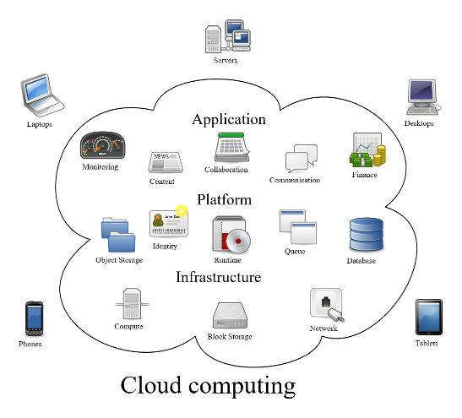
Definitions
Cloud computing is shared pools of configurable system resources and higher-level services that can be rapidly provisioned with minimal management effort, often over the Internet.
Cloud computing is a group of networked elements providing services need not be individually addressed or managed by users
A vast network of remote servers around the globe hooked together and meant to operate as a single ecosystem.
There are several different cloud delivery models available, e.g., public, private and hybrid. The table below depicts only the main differences between them.

Slide 4




Definitions (cont’d)
Different Cloud Delivery Models (architecture, ownership & responsibilities)
vs.
vs.
Hybrid
Private
Public
Combines on-premises private clouds, with public clouds
Cloud bursting option to handle demand spike using public
High Scalability
Improve Cost
High reliability
Resources used exclusively by one organization
Can be physically located at your on-premise datacenter
Most Secure
Good Performance
High reliability
Most Common
High Scalability
Near-unlimited scalability
Pay As You Go
Share hardware, storage, and network devices with other “tenants”

Slide 5
ACE Cloud Vision and Strategy
What is driving the cloud strategy at ACE?
Manage technical and business risks in support of ACE transition to leveraging cloud services
Ensure that potential cloud benefits are captured and measured
Deliver capabilities and products to faster to improve members experience
Improve service and serve more customers digitally
Grow the internet delivery channel
Adopt an ACE corporate-wide approach to cloud computing
Develop an ACE specific Enterprise Cloud Computing Concept of Operations
Increase the efficiency of current and future IT Program investments
What are the challenges?
Application readiness takes much longer than expected due to tight restrictions
Lengthy procurement & approval process
New product/service takes more than 9 months to deliver
Lack of DevOps automation. Most processes are manual
Legacy (mainframe) systems not built/setup for distributed transactional processing
Connectivity issues with the mainframe (several hops to reach datastore(s)) cause performance issues
Firewalls and permissions require lengthy lead times
Limited logging and monitoring
Limited/inadequate cloud development skillsets

Slide 6

ACE Cloud Adoption Strategy Summary
As ACE is getting ready to move into the cloud, ACE team will adopt an agile, low-risk, and time-tested strategy called Agile Cloud Adoption and Migration (ACAM) . ACAM is a modular and lean strategy which allows to only use its useful elements and discard the rest. The initial scope will be limited to a selected set of application(s). The data will remain in ACE datacenter(s), except for the public data, while compute instances will be operating in the cloud. The following is a brief overview of its phases and activities for a successful journey:
Business Strategy Definition – ACE team will document the business goals and desired outcome ACE is pursuing with the cloud. It will guide the remainder of the migration journey.
Planning – it is the most important phase of this strategy. We will collect cloud related important data points from business units such as, eBusiness, ClubLabs, and Big Data, make necessary organizational changes, acquire necessary skills, and devise a standards base and vendor agnostic approach. Review and revise our governance and security policies and processes, when necessary.
Analysis & Classification of Workload – We will utilize multiple frameworks and processes to ensure the target platform and delivery models match the intended plans. ACE team will conduct the cloud and the vendor fitment analysis to ensure the best business value.
Preparation of the Target cloud - ACE team will create necessary resources, ensure privacy, protection and confidentiality. Compliance, governance, and regulation policies will be setup and validated. We will implement zero-trust policy.
Create Migration Execution Plan - ACE team will devise a careful, scenario based migration execution game plan. The team will discover dependencies and relationships to ensure successful migration, create traffic re-routing plans, do the migration and validate its results.
Execute Migration Plan - This phase may be completed in multiple subprojects. It is comprised of setup, configuration, implementation, and deployment of cloud elements or services. The details of each subproject may vary, but the general plan is the same. After each iteration, the team will validate the migration results and make process improvements, if necessary.
Security and Governance – ACE team will utilize appropriate security models to ensure the trust worthiness of cloud computing. An effective governance model will be used for frictionless management and operations.
Automation - It alleviates the complexity, significantly improves repetitive, manual, labor intensive and error-prone tasks, and simplifies cloud management. There is no single cloud automation tool, platform or framework, but plenty of tools are available in the market. Automation is a journey, not a sprint.
Optimization - Optimization is an ongoing activity; ACE team will perform it whenever there is an opportunity or the need for it. Automations will be to maximize Optimizations such as, dynamic, configuration based scalability, availability, and resource consumption.
In a nutshell
Plan, plan, plan
Perform thorough analysis and classification
Create a dedicated team
Cloud service decisions must be business problem based
One size does not fit all
An opportunity to downsize, right-size, optimize, and turn off unused environments
Consider a hybrid strategy

Slide 7
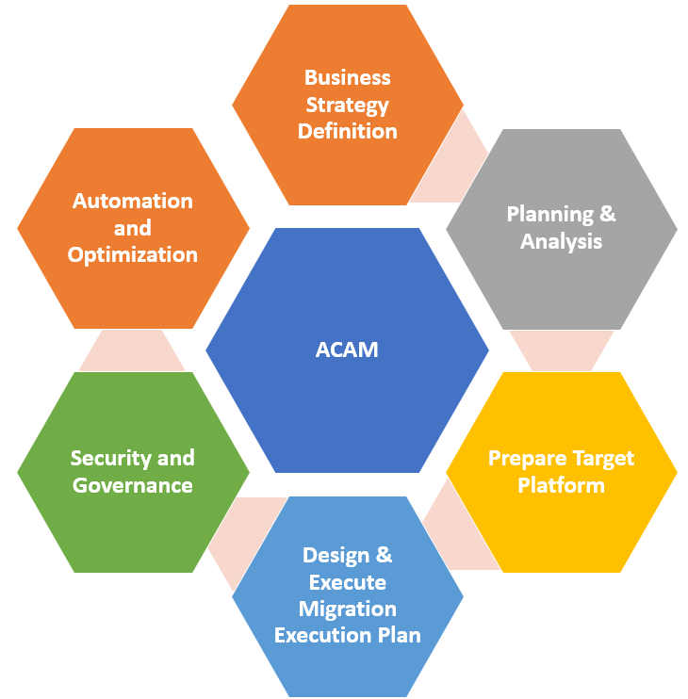
Adoption Model
Each organization’s cloud adoption journey is unique. There is no “one suit fits all model” in the Cloud.
The ACAM model is a modular framework which allows you to use its useful elements and discard the rest. This model is called Agile Cloud Adoption and Migration (ACAM) model.
Agile does not mean unstructured or without a plan.
The ACAM model is comprised of Business Strategy, Planning & Analysis, Target Platform Preparation, Creation & Execution Migration Plan, Security & Governance, Automation and Optimization phases.
Each specific use case may be different in adopting the cloud, but the core knowledge presented herein is necessary to begin the process is common to all.
It is intended to help ACE develop efficient and effective plans for the cloud adoption journey.
It can be repeated to make short timeframe intervals for incremental improvements.
ACE team will initially focus on eBusiness, ClubLabs, and Big Data projects.
For SaaS solutions such as, HCM and LMS, ACE will decide the division of controls and responsibilities with the service provider.

Slide 8

Business Strategy Definition
Clearly define business goals and desired outcome ACE is pursuing with the cloud, identify stakeholders, and define metrics to be used to measure the project progress, benefits, and the degree of compliance with the business goals. Document the business and technology goals and expected outcomes.
Articulate rationale of ACE is moving to the cloud.
Helps create working plan(s) to achieve its vison, prioritize objectives, and optimize resources
Make intelligent decisions and allocate resources to accomplish key objectives
Helps setting the strategic direction
Identify stakeholders
Helps learn the champions and the decision makers, which are vital to success of this initiative
Define outcome metrics
ACE team will be able to understand whether they’re moving toward or away from the stated goals
Ensures ACE balances business value of its IT investment and business risks
The initiative could be business or technology related
The goals are not limited to the business only; they can be technology related as well

Slide 9

Planning
Moving enterprise data and applications outside enterprise datacenters into the cloud is no small feat. ACE team will plan carefully and diligently – rushing through it will be a fatal flaw!
The teams will be comprised of Executive Committee, Steering Committee, Working Group, and Cloud Product teams. The detailed responsibilities of each group are specified in separate slides. However, in a nutshell -
Executive Committee provides overall direction and guidance and aligns organization’s goals and objective to the outcome
Steering Committee reviews ACE security posture, finalize policies and provide approvals
Working Group is the cloud SME group that develops policies, procedures, reference architectures, templates and roadmaps
Cloud Product Teams develop components and products to be deployed. Configurations and operations support, diagnose and resolve issues and operational insights
Assemble Cloud Governance Teams
Establish Develop Cloud Migration Principles
The team will follow the principles of go fast, push the boundaries, make data-driven decisions, simplify, and communicate
ACE team will review and revise its governance and security policies. Governance methods that worked for traditional on-premises systems possibly won't work for the cloud
We will rely less on internal security and control, and more on the selected cloud provider's offerings
The team will ensure the cloud governance, data governance, financial governance, and security responsibilities on various service models
ACE team will define and implement change management governance policies
Governance & security Policies
Security
ACE will thoroughly assess business risks for apps moving to the cloud
All dimensions of security policies will be re-evaluated to determine whether they need to be updated
Provider security controls, such as firewalls, role-based access controls, encryption or tokenization will also be fully understood
Setup Service-Provider Agnostic Networking
We will make WAN infrastructure service-provider agnostic
Evaluate networks re-architect the WANs
A regionalized connectivity approach instead of a traditional (MPLS) approach
The team will investigate and adopt software-defined WAN
Assign a dedicated Cloud Architect and a Cloud Core Team
The cloud architect will direct a cloud core team to address organizational transformation
The primary responsibility is to instill a cultural re-orientation toward the cloud
The architect will not conduct all the cloud transformation, but he/she will orchestrate the changes

Slide 10
Planning (cont’d)
ACE will implement standards-based identity federation solutions, such as SAML and OpenID Connect
Provide on-premise and cloud directory synchronization, if needed
Update current procedures and policies to support Authentication and federation, timely identity provisioning and support for compliance
Identity Management
Infra/Storage/Data
ACE may implement a hybrid architectural approach for cloud-based backup or disaster recovery
ACE will decide whether cloud native or 3rd party vendor or on-premise infrastructure elements to use
ACE team will establish a Data Protection Strategy that Spans the datacenter and the Public Cloud
Ensure you have the right skills
We will ensure ACE has the necessary skills – a multi-prong strategy will be adopted, e.g., developed in-house, acquired, or outsourced
Organizational Change
The cloud era may also necessitate new roles, such as “urban planner”, “trusted advisor”, “it works”, etc.
Critical Business Data Collection
Ace team will create a cohesive strategy involving main business units and IS organization
Start with Hybrid Architectures
ACE team will use Hybrid Cloud Architectures as the preferred way to start utilizing the cloud
The team will implement the integration between on-premise and migrated systems, focusing on networking, governance, security, identity management, and infrastructure/storage/data
Cloud Readiness Assessment
ACE team will conduct a Cloud Readiness Assessment of Technology, Infrastructure, Network, Security and vendor agreements to ensure successful cloud migration and operations.

Slide 11
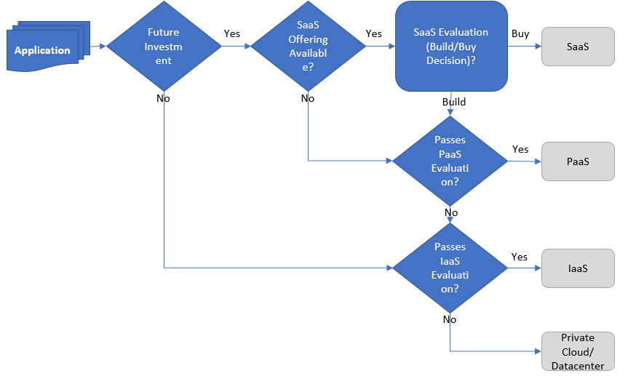
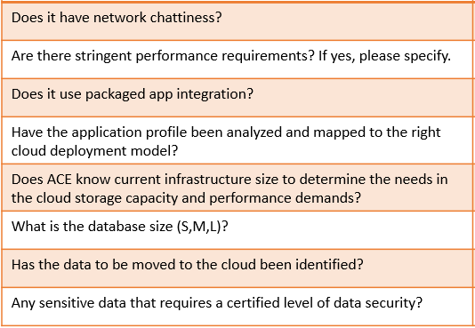
Analysis & Classification of Workload
The biggest challenge is changing the culture and mindset
Switch from a strategic focus on developing technology solutions to measuring business benefits
It is an evolutionary journey
Consider the following two factors when evaluating an application for cloud migration: technical complexity and business impact
Start with the least technically complex application that has the least impact on business
The strategy would be to make decisions based on the difficulty of the project and expected benefits
If the application didn't work in the cloud, the team would understand why the application failed and how to fix the issue. If the problem could not be resolved, the application would remain in the datacenter.
Are capabilities critical to an application available in the cloud?
If a Business Unit (BU) develops a new application, the application should run in platform as a service, PaaS, a pure cloud environment.
If an existing application is moved to the cloud, the application should be re-architected to run in PaaS or re-hosted to run in IaaS, infrastructure as a service.
If an application is moved to the cloud and no further investment is planned for redevelopment, these applications should be re-hosted in IaaS
If an application will either be re-architected or is a net new application, it should be developed for PaaS or SaaS, software as a service.
Investment/ Value Analysis Framework
Workload Characteristics Analysis Framework

Slide 12
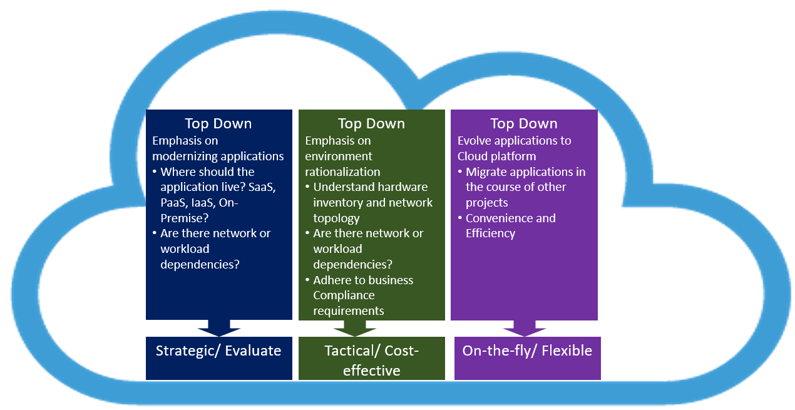
Analysis & Classification of Workload (cont’d)
ACE will leverage multiple approaches and business drivers to formulate the migration strategy.
Analyze IT operations for cost optimizations to buy, maintain and refresh required software.
ACE IT Programs as cloud service consumers can use a flexible utility-type, pay-per-use model to pay only for IT services they need and consume.
The Governance teams for these pay-per-use models will ensure the compliance of the ACE security & VRM standards.
ACE Cloud Migration Framework

Slide 13
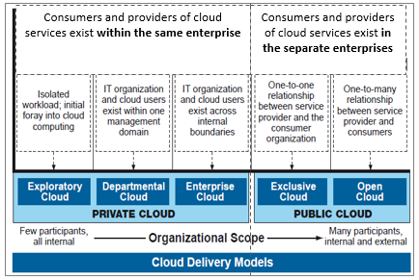
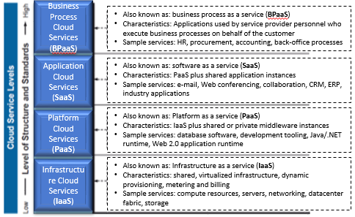
Analysis & Classification of Workload (cont’d)
Application to Cloud Fitment
Legacy applications, mission-critical workloads and sensitive data, such as, credit card might not be the ideal candidates for cloud migration.
Hybrid or private cloud will be a part of ACE cloud migration strategy.
ACE team will be aware of the public cloud, being a multi-tenant environment - means shared resources.
It will help the team decide the right cloud delivery model based on the understanding of its purpose and security concerns.
Fitment Models
Choose the right Cloud Deployment Model
Select the right service levels based on our purpose and maturity level. It may result in a combination of different types of service levels.
Public clouds such as, AWS and Azure are not ideal candidates for certain application types, e.g., healthcare, financial services, etc.
ACE has responsibility to ensure proper security controls are in place.
Private clouds offer more control, but management, performance monitoring and more become ACE responsibilities.
Hybrid cloud offers best-of-breed, but it will still require for ACE to address performance, latency and dependency concerns.

Slide 14
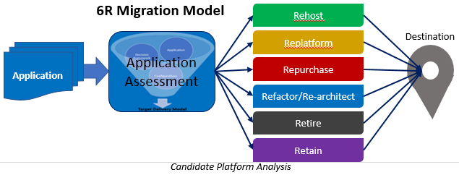
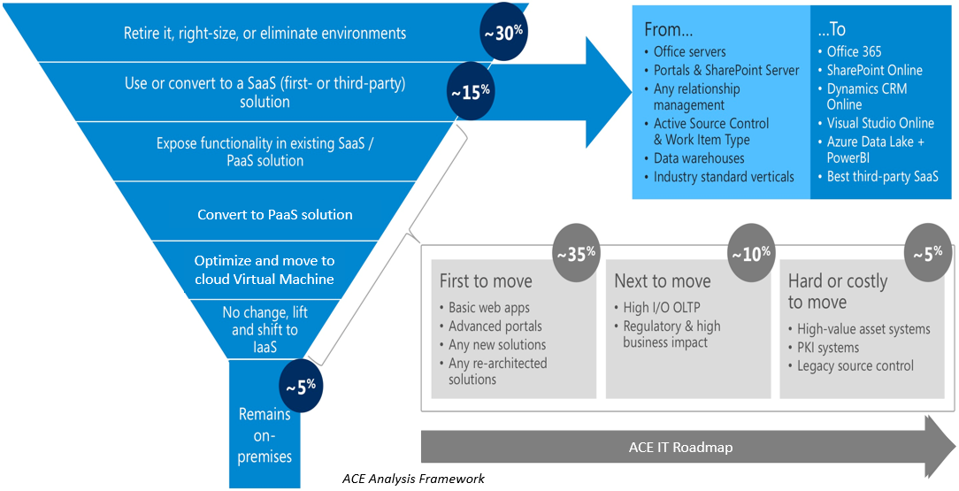
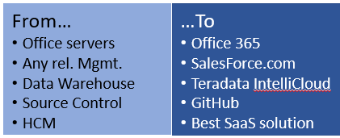
Analysis & Classification of Workload (cont’d)
Multiple Strategies - ACE will adopt multiple strategies to analyze and classify the workload
Develop a comprehensive and holistic analysis framework of ACE IT services to identify candidates for cloud adoption based on benefits and risks to ACE.
An enterprise-level ACE analysis for consolidation and optimization opportunities for cloud adoption.
Share this analysis with the Product/Program Management Teams for consideration and analysis.
Provide guidance for the type of cloud deployment and service model to use based on the type of workload.

Slide 15
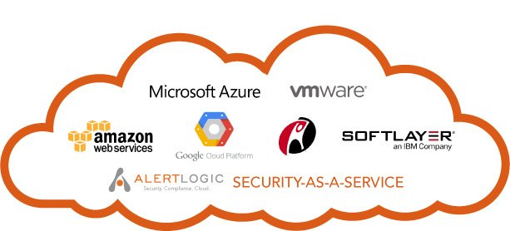
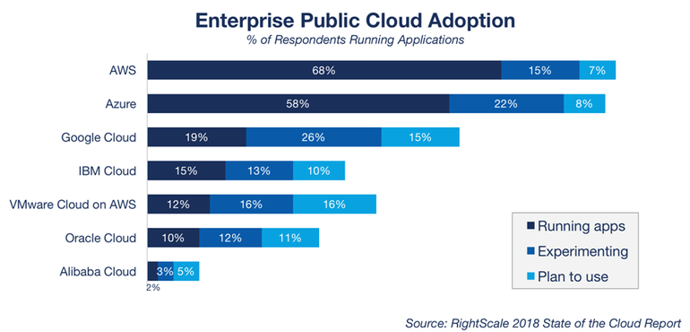
Analysis & Classification of Workload (cont’d)
Which Cloud Provider offers best value?
Determine which cloud provider offers the best value for the same service
Don’t just select the market leader, learn the provider strength, and judge whether it meets your business needs
Based on your database size/ capacity demands you can decide if a provider can actually deliver the level of service you need
How much will it cost? Be sure to know exactly how your applications will operate in the cloud; look for hidden charges based on things like messages sent, bandwidth, API calls, and even geographical location.
ACE might utilize one provider for production, and a second for disaster recovery to minimize risk
ACE will attempt to leverage discounts or other cost-saving opportunities
Financial aspects may also affect our decisions, e.g., align to existing investments
The portability and an exit strategy is going to be a significant determining factor for us. ACE will insist on full exit strategy
Tighter integration with the preferred ecosystem of vendors could also be an influencing factor
It will enable:
A multi-provider strategy and design approach
A management strategy, and broker cloud services to the business

Slide 16

Preparation of the Target Cloud
The implementation details might vary from cloud provider to cloud provider, at minimum, you would have to perform the following tasks, before moving anything to the cloud:
Create an appropriate account
Create a resource group, a storage account, and a Recovery Services Vault
Set protection goals
Create and define an Identity and Access Management
Ensure there is an up-to-date (synchronized) authentication and authorization store(s), e.g., Active Directory
After thorough review and revision of compliance, governance, and regulation policies, ensure they are in place and independently verifiable
Use secure storage account to store your VM images, configurations, automations, runbooks, source code, and binaries
Secure your key vault
Ensure data security (at-rest and in-flight) and data privacy. Know who is accessing it, and how it is used, and provide independent audit thereof
We will implement zero-trust policy
Make sure the network is implemented as planned
Ensure robust monitoring and logging are enabled
You may want to conduct penetration and DDoS testing
Ensure your operations team is ready to manage, operate, and monitor

Slide 17

Create Migration Execution Plan
ACE team will devise a careful migration execution game plan. The details of the actual migration may vary depending on the cloud provider’s tool set, the following is a cloud migration example (based on Microsoft Azure platform):
Create scenario based migration
Select apps to be migrated
Prioritize them (start with small and least critical apps)
Discover dependencies and relationships
Determine its readiness (readiness assessment)
Create prioritized migration groups
Create a communication plan
Notify stakeholders
Configure replication settings
Configure failover direction (on-premise datacenter → cloud)
Plan failover
Stop on-premise apps
Do the migration (apps & data) based on the migration strategy
Manual - Manually migrate to the cloud (for small projects)
Automated (ASR) - Migrate apps and data.
Force failover
Reconnect on-premise links to the cloud
Conduct connectivity, functionality, security, and performance testing
Notify stakeholders
Optimize/Innovate the process/tools
Repeat as necessary

Slide 18

Execute Migration Plan
This phase may entail one or many subprojects depending upon the scope and goals.
It is comprised of setup, configuration, implementation, and deployment of cloud elements or services designed in the Design and Plan phases.
Each specific solution must be deployed according to the general plan.
There might be different approaches for different subprojects, e.g., implementation details of Coupa, HR (SaaS) Solution are different from migrating the eBiz project the cloud (PaaS/IaaS).
ACE team will also define and manage activity stream(s) that span across all phases, e.g., the project management and the change management.
Execute the migration plan
Validate the migration results
Make process improvements, if necessary
Repeat as needed

Slide 19
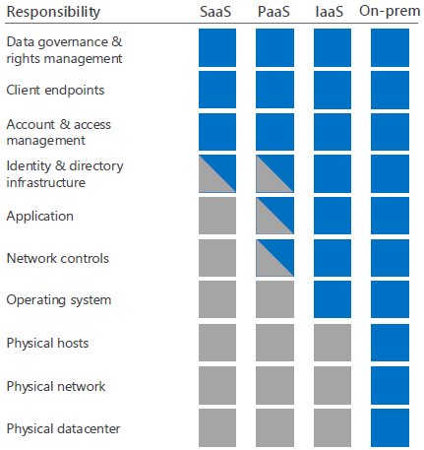
Overview of Cloud Security Ownership and Responsibility
Security in the cloud is a shared responsibility
Provider cloud services are built on a foundation of trust and security. Provider provides ACE security controls and capabilities to help ACE protect its data and applications.
ACE owns data, identities and cloud components its controls (varies by service type) and is responsible for protecting them.
Private
Responsibility
- ACE
Division of Responsibilities in the Cloud
- Provider
The responsibilities and controls for the security of applications and networks vary by the service type.
SaaS (Software as a Service)
Provider operates and secures the infrastructure, host operating system, and application layers. Data is secured at datacenters and in transit between provider and ACE. ACE control access and secure data and identities, including configuring the set of application controls available in the cloud service.
PaaS (Platform as a Service)
Provider operates and secures the infrastructure and host operating system layers. ACE control access and secure its data, identities, and applications, including applying any infrastructure controls available from the cloud service. ACE control all application code and configurations.
IaaS (Infrastructure as a Service)
Provider operates and secures the base infrastructure and host operating system layers. ACE control access and secure data, identities, applications, virtualized operating systems, and any infrastructure controls available from the cloud service.
Private cloud
Private clouds are single tenant solutions that are owned, operated, and secured by ACE. Private clouds differ from traditional on-premises infrastructure in that they follow cloud principles to provide cloud availability and flexibility.
ACE cloud elements they control and manage. ACE has the responsibility of maintaining, operating and protecting those elements.

Slide 20
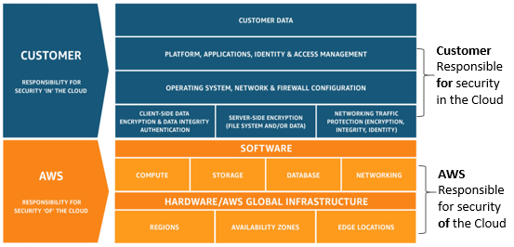
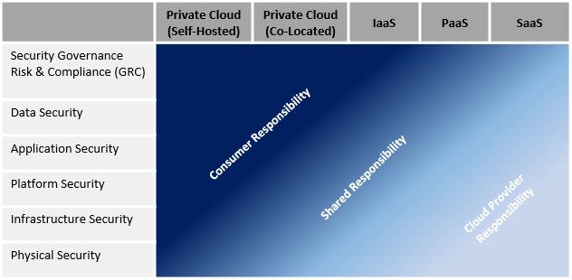
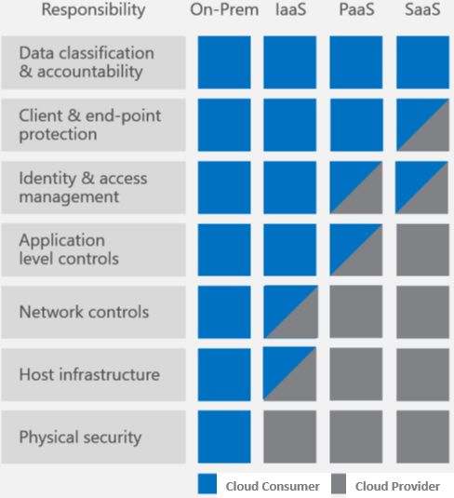
Cloud Providers Security Positions (Azure, AWS, IBM only)
Division of Responsibilities in the Cloud
Amazon Web Services (AWS) Cloud Security Position
Private
IBM Cloud Security Position
Microsoft Azure Cloud Security Position

Slide 21

Cloud Risks
Vulnerabilities, risks and guidelines
Vulnerabilities
Meltdown pertains to exploiting vulnerabilities with the underlying processor (CPU) running the code to access information. Both Spectre and Meltdown permit side-channel attacks because they break down the isolation between applications, VMs, etc.
In the case of Meltdown, the only way to address this is to aggressively “detune” code (including application code) and force the processor to behave correctly. In the case of Spectre, we don’t yet know how to mitigate it.
Cloud providers (public, private, and hybrid) are all potentially affected by these vulnerabilities, so they must guard against them by ensuring that all the latest patches are in place. Patched are not yet available for all of these vulnerabilities.
Risks
An attacker that is able to access a system through unprivileged log in can read information from the kernel, or can read the host kernel if she is a root user on a guest virtual machine (VM). In a cloud environment, this can be used across customers and cannot be detected.
This is a huge issue for cloud service providers. The patches might degrade performance, so some businesses might choose to leave their systems unpatched.
Guidelines
The CERT Advisory is recommending the replacement of all affected processors. (Note: Replacement processors are not yet available). ACE must demand information on how their cloud providers (vendor and internal) are responding to Meltdown and Spectre, and other side-channel vulnerabilities.
ACE must not mix workloads from different security zones on the same host.
ACE must evaluate workloads vs. these risks when determining what cloud services to use.

Slide 22
Security Reference Architecture
Identity and Access Management
Monitoring
Identity Mgmt.
Authentication Services
Authorization Services
Single Sign-on
Middleware AuthN
Policy Enforcement
Rule Management
Federated Identity
MFA
SAML
Network AuthN
Network
Identity Provisioning/Deprovisioning
Password Management
Policy Definition
Policy Distribution
Attribute Provisioning
Password Vault
PAM
Policy Contract
Infrastructure
InfoSec Management
Governance, Risk & Compliance
Platform
Compliance Mgmt.
IT Risk Mgmt.
Risk Portfolio Mgmt.
Capability Mapping
Risk Dashboard
Risk Register
Training & Awareness
Audit Mgmt.
Policy Mgmt.
Vendor Mgmt.
Data Protection
Web & Cloud Apps.
Data Lifecycle Mgmt.
Data Evaluation
IP Protection
Data Leakage Protection (DLP)
Data Mining
Data Tagging
Data Dictionary
Domain Transfer
Incident
Lifecycle
Data Loss
Intellectual Prop.
Domain Use
Cryptographic
Database Security
Data Governance
Security
Key Management
PKI
Database Firewall
Data Classification
Data Label
Data Retention Rules
Encrypt Data at-rest
Encrypt Data in-flight
Database Security
Data Ownership
Secure Data Disposal
Leakage Prevention Rules
SaaS
Infrastructure Protection Services
Operational Risk Mgmt.
Server
Network
Application
HIDS
AV
IDS/IPS
Firewalls
XML Firewall
Code Review
Whitelist
Firewall
DPI
WAF
Threat Modeling
OWASP
Make Assessment
Policies & Standards
Legal Services
Internal Investigation
Make Risk Decision
Technical Security Standards
Best Practices & Regulatory
Contracts
InfoSec Policies
Operational Security
Data Classification
Discovery
Incident Legal Svcs.
Parasitic Analysis
Email Journaling
Comm. Risks & Intentions
Threat & Vulnerabilities
Implement Controls
Compliance Testing
Vulnerability Testing
Vendor Assessment
Threat Management
Storage
Infrastructure
Pen Testing
Network
Ethical Hacking
Datamart
Server
Datamart
Application
Vendor Risk Assessment
Email
Reporting
Logging/SIEM
Document Retrospection
Implementation based on risk

Slide 23
ACE Cloud Security Principles
Define protections that enable trust in the cloud.
Develop cross-platform capabilities and patterns for proprietary and open-source providers.
Provide trusted and efficient access, administration and resiliency to consumer.
Cloud native will be preferred.
Provide direction to secure information protected by regulations.
Architectures will facilitate proper and efficient governance, identification, authentication, authorization, administration and auditability.
Centralize security policy, maintenance operation and oversight functions.
Access to information will be secure and easy.
Delegate or Federate access control where appropriate.
Security patterns will be easy to adopt and consume.
Architectures will address and support multiple levels of protection, including network, operating system, and applications.
Zero Trust Networking-Security policy will be adopted.

Slide 24
ACE - As-is Cloud Security State
ACE Data Classification are guided by the policies/controls
ACE Security Readiness for the cloud
Information security Policy
Vendor Risk Management (VRM)
AAA National TQS#5
AAA National security policies, adopted by ACE are specified in TQS #5. They're specified at a high level
For ACE to use them effectively and efficiently, we would need to equip ourselves with –
Reference architectures, patterns, templates, prescriptions, realization details, reusable components and samples, especially from the cloud perspectives
The document is about two years old and need to be reviewed and revised
The following mitigation strategy will be adopted:
Document our architecture and integration points
Design the security architecture to address potential concerns
Review them with security SMEs and the technical leaders
Document security principles and catalog the implementation patterns
Submit them to the security team to be added to the security principles, policies, and standards
Public
Confidential
Restricted
Confidential
Internal Use Only Information
Public Information
Sensitive Regulated Data
Highly Confidential
Confidential
Internal
Public
Cloud Security (risks of moving to the cloud)
Facts
Fiction
Maturity
Models potentially include “sharing space and services with your biggest competitors”
Cloud providers can represent attractive information/trade secret asset aggregation points to attackers
Varying service types and providers carry different risk profiles
Auditing and certifications vary “in the cloud”
Auditing and certifications are more complex, and provide good reference points, but cloud “consumers” are ultimately accountable for their data
Change control/security capabilities can be limited with flexibility varying materially due to “shared” nature of cloud services.
Cloud services cannot be reliable
Cloud services are inherently less secure than on-premise
Certifications such as SSAE 16 type I/II indicate provider services are secure
Regulatory concerns/factors do not vary from on-premise solutions
Data recovery, e-discovery processes, and related obligations are not evolving
Data residency locations cannot be controlled for most enterprise services
Standard basic controls (firewalls/authentication/encryption) are present for most corporate enterprise offerings, meet most needs, and are maturing
Hybrid integrated advanced cloud enterprise security tools such as Data Loss Protection (DLP), integrated security “views”, customer specific alerting, are nascent and evolving
More complex and specialized architecture requirements
Material reliance upon sustainable service provider execution
Remember – Cloud security is a shared responsibility!

Slide 25
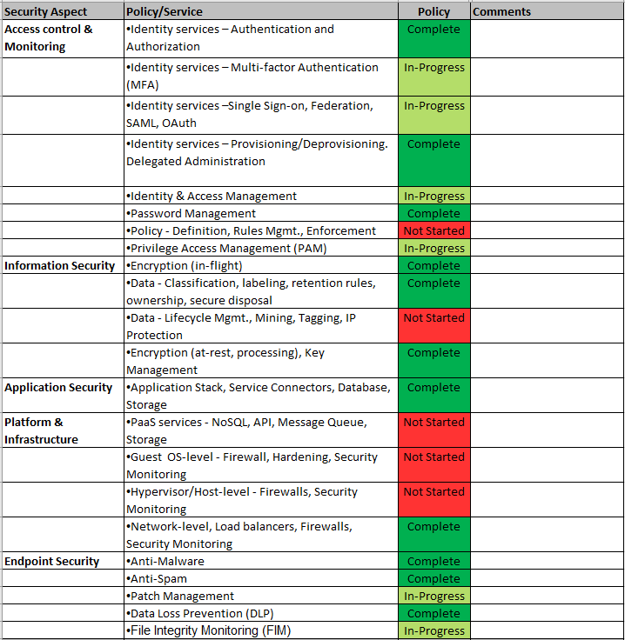
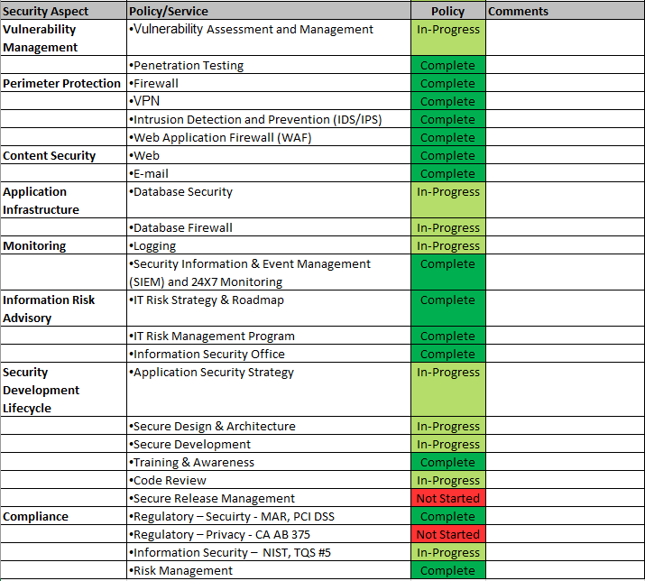
ACE Security Current Standards

Slide 26
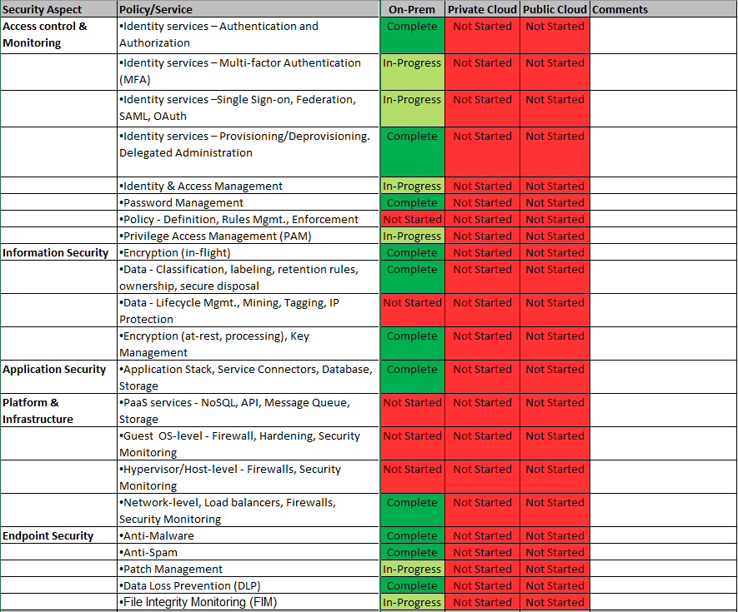
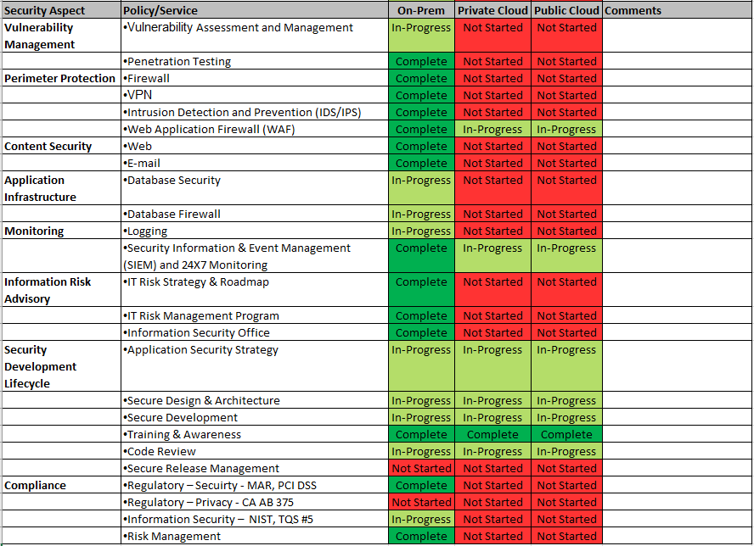
ACE Cloud Security Roadmap
Each potential public cloud provider such as, Azure, AWS, will be assessed for maturity.

Slide 27
ACE Cloud Governance Teams Structure
Provides Sponsorship and funding
Executive Committee
Steering Committee
CIO
(Chris S.)
Delivery
(Garrett A.)
CISO
(Andrew B.)
Chief Arch.
(Goutham N.)
InfoSec
(Andrew B.)
Prod. Delivery
(Gordon S.)
Support, Helpdesk
(Ildiko A.)
Solutioning, BI, PMO
(Lance W.)
eBiz
(Erik R.)
Big Data
(Seiji A.)
Engineering
(Craig T.)
eBiz/ClubLabs
(Guy O.)
Info. Systems
(Bill W.)
Consults and Recommends
Working Group
Networking (Juan V.)
Converg’d Infra.
(Henry S.)
Ent. Comp.
(Tim P.)
Initiative and Guidance
InfoSec
(Jim M.)
EA
(Dave C.)
EA Networking (David D.)
eBiz/ClubLabs (Guy O.)
Procurement (Mark R.)
End-user Comp.
(Tara P.)
Provides guidance & support
Cloud Product Teams
NOC
(TBD)
Infra. Architect (TBD)
BI Specialist (TBD)
DR Architect (TBD)
Infra. Security Architect (TBD)
Helpdesk Support (TBD)
Systems Eng. (TBD)
Apps Component & Feature Teams
These roles are subject to revision based on guidance provided by ACE leadership.

Slide 28
ACE Cloud Governance Teams and Responsibilities
Executive Committee
Steering Committee
Working Group
Cloud Product Teams
Provide Sponsorship
Provide execution resources and funding
Provide overall direction and guidance
Align organization’s goals and objectives to the outcome
Overall responsibility for the decisions made by the cloud committee
Review ACE security posture
Provide oversight to policy definitions
Finalize policies
Provide Approvals
Decide on frequency of reviews and revisions of policies
Develop policies and procedures and present to the Steering Committee
Make recommendations and decisions to move to cloud
Develop reference architectures, templates, sample codes and implementation roadmaps
Provide guidance to security compliance
Identify deployment and service models
Identify security domains
Define asset and user classifications
Identify communication patterns and integration touchpoints
Identify gaps, vulnerabilities & make tradeoff decisions
Review choices, approaches, benefits and pitfalls
Assemble team with appropriate skills
Evaluate products, tools and make recommendations
Secure approvals and sign-off
Operationalize approved policy (publish reports)
Provide security operation support
Operations monitoring and support
Provide helpdesk support
Provide fixes and enhancements
Analyze, diagnose, and resolve issues
Implement patches and changes
Implement DR
Provide analytics and insights
Policy full lifecycle
Policy maintenance
Policy related contracts
Cloud Security Assets
Policies & Procedures
Reporting & Communications
Technologies & Toolsets
Roadmaps
Typical Initiative and Guidance workflow
Typical Measures and Issues workflow

Slide 29

Automation (ongoing)
Cloud automation is a fundamental building block for the cloud computing paradigm
It is intended to alleviate the complexity inherent with cloud computing orchestration
It significantly improves repetitive, manual, labor intensive and error-prone tasks.
It simplifies cloud management; connect into any system exposing an API and integration into many cloud provider services.
There is no single cloud automation tool, platform or framework. Offerings range from on-premises tools to public cloud hosted services, e.g., Puppet Enterprise, Chef Automate; automation services - Azure Automation and AWS' Elastic Compute Cloud Systems Manager.
Automation tools help ensure the system is performing optimally and all deployment and resource allocation requests are fulfilled quickly and efficiently.
Automation is a journey, not a sprint. ACE team will develop and mature automation practice as the team fleshes out our process(es) and gains more experience and comfort.
Some automation examples: software defined web-scale IT, CI/CD thru Rapid resource deployment and scaling, auto-provision virtual servers, Provision version control for workflows, back up data on regular intervals, common configuration items, drive cloud integration process, remove zombie cloud instances

Slide 30
Optimization (ongoing)
Once a project is operational in the cloud, it is time to start measuring results and comparing with the metrics and goals that were initially established. ACE team will feed newly discovered improvements into the process.
Optimization is an ongoing process
ACE team will perform it whenever there is an opportunity or the need for it
Set up and implement application monitoring and tracing
Measure and optimize feature, functionality, performance, and scalability
Operational data can assist in debugging, troubleshooting, monitoring resource usage, traffic analysis, capacity planning, and auditing
Review Infrastructure, IT and operational Optimization Models
Optimize
Operationalize
Create
Design
Plan
Automate
Initial Optimization Opportunities
Manage cloud deployments
Monitor cloud consumption
Cost Optimization
Process Optimization
Cloud Governance Metrics
Active Cloud Risk Reduction
Cloud Compliance Outcomes
Automated Quality Assurance
Data Insights
Operational Health
Continuous Service Mgmt.
Feedback loop
Become service broker
Cloud Readiness
Automation Opportunities
New Activities

Slide 31

Key Takeaways
A Clear and concise vision is the key to the successful migration to the cloud
Plan, plan, plan
Security in the cloud is a shared responsibility. Understand your responsibilities
An effective governance model for frictionless management and operations
Perform thorough analysis and classification of workload
A team dedicated to driving cloud adoption is critical to success
Drive cloud adoption through both the technical expertise of IT and through senior leadership providing leadership, training and support
Every cloud service decision must provide a solution to a business problem. But, balance business and technical factors in making those decisions
Remember that one suit does not fit all. You should determine how to grow cloud services
Use the cloud as an opportunity to downsize, right-size, optimize, and turn off unused environments to combat server sprawl
Use the scalability capabilities of PaaS when developing or re-architecting applications for the cloud
Consider a hybrid strategy when moving multi-tier applications to the cloud
Keep applications in the cloud modular to take advantage of cloud resiliency
Takeaways
Recommendations:
Evaluate public cloud as an accepted deployment model.
Determine the level of automation and self-service required.
Evaluate hosted private cloud as an alternative to building a private cloud.
The order of preference should be BPaaS, SaaS, PaaS, IaaS.
The Cloud Maturity model should be IaaS, PaaS, SaaS, BPaaS.

Slide 32
Appendix

Slide 33
ACE Cloud Governance Teams Structure
Provides Sponsorship and funding
Executive Committee
Steering Committee
CIO
(Chris S.)
Delivery
(Garrett A.)
CISO
(Andrew B.)
Chief Arch.
(Goutham N.)
InfoSec
(Andrew B.)
Prod. Delivery
(Gordon S.)
Support, Helpdesk
(Ildiko A.)
Solutioning, BI, PMO
(Lance W.)
eBiz
(Erik R.)
Big Data
(Seiji A.)
Engineering
(Craig T.)
eBiz/ClubLabs
(Guy O.)
Info. Systems
(Bill W.)
Consults and Recommends
Informs
Working Group
ACE Organization Structure
Networking (Juan V.)
Converg’d Infra.
(Henry S.)
Ent. Comp.
(Tim P.)
CIO
(Chris Simpson)
InfoSec
(Jim M.)
EA
(Dave C.)
EA Networking (David D.)
Initiative and Guidance
Lance Weaver
Andrew Bereczky
Garrett Anderson
CLO
(Avery B.)
eBiz/ClubLabs (Guy O.)
Procurement (Mark R.)
End-user Comp.
(Tara P.)
EA
(Goutham N.)
Security Arch. (Jim M.)
Information (Craig T.)
CPO
(Mark R.)
Provides guidance & support
PMO
(David K., et al)
Acct. Mgmt.
(Linda W., et al)
Service Mgmt. (Ildiko A.)
CDO
(Erik R.)
Cloud Product Teams
Business Arch. (Saurav B.)
Tech. Accel. (Sathya R.)
Product Dlvy. (Gordon S.)
eBiz/ClubLabs (Guy O.)
NOC
(TBD)
Infra. Architect (TBD)
BI Specialist (TBD)
BI
(Scott K.)
Product Assur. (Bob W.)
DR Architect (TBD)
Infra. Security Architect (TBD)
Helpdesk Support (TBD)
Systems Eng. (TBD)
Apps Component & Feature Teams
These roles are subject to revision based on guidance provided by ACE leadership.

Slide 34

Cloud Service Provider Assessment Checklist
AUTHENTICATION AND IDENTITY
Is multi-factor authentication available
Does the cloud service provider allow for anonymous access to the service?
What single sign-on methods does the cloud service provider support?
Is integration with enterprise directories or authentication providers supported?
Customer Data Protection
Is data encrypted at-rest in its databases, file systems or at the virtual machine layer?
What mode of SSL or TLS does the vendor support for protecting data in motion?
Is multitenant offering supported?
INTERNAL CONTROLS
Which compliance certifications does the cloud service provider have (e.g. SSAE16, ISO 27001, SOC2, PCI, HIPAA, etc.)?
What measures are in place for datacenter protections?
Does the cloud service provider log end-user activities?
LEGAL TERMS
Are definitions IP ownership for the cloud service provider documented?
What are the grounds for account termination with the cloud service provider?
How long does the service store customer data after account termination?
Does the service reserve the right to share customer data with third parties?
PAST PERFORMANCE
Has the cloud service provider had a (publicly disclosed) breach in its service?
Is the cloud service provider known to have malware hosted on its site?
Does the vendor perform penetration testing on a regular basis?

Slide 35
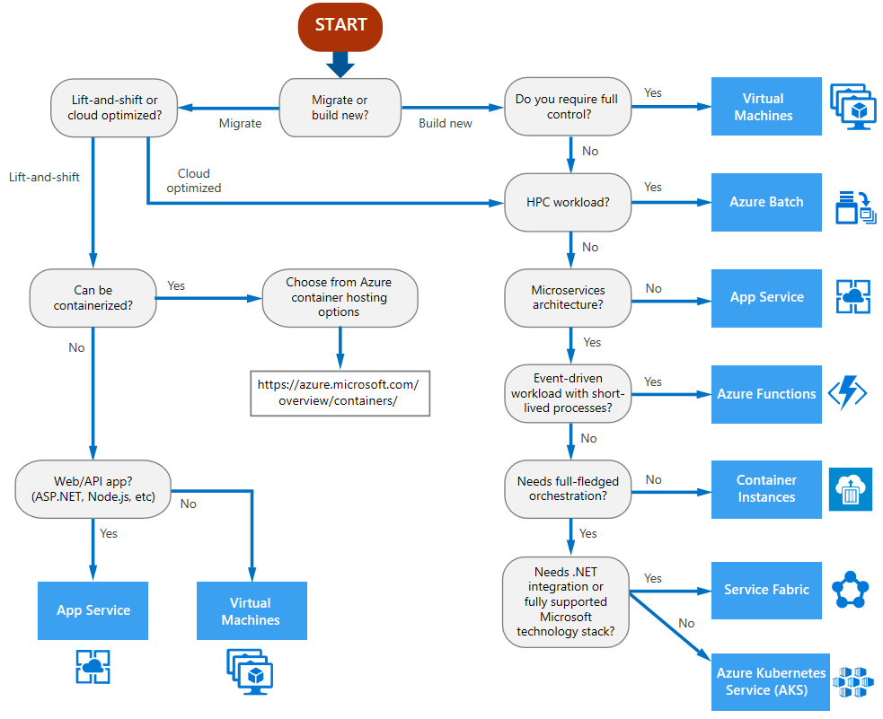
ACE Cloud Migration Target Decision Tree

Slide 36
Mapping ACE Cloud Security Patterns to Cloud Patterns
(Representational)

Slide 37
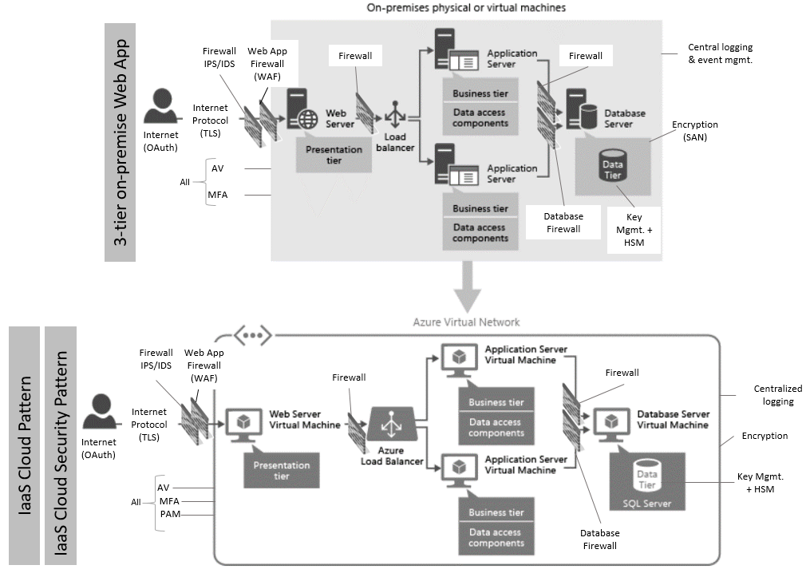
3-tier web app migrated to IaaS Platform
The Risk model will determine which controls are required.
It might necessitate to add or remove controls as appropriate.

Slide 38
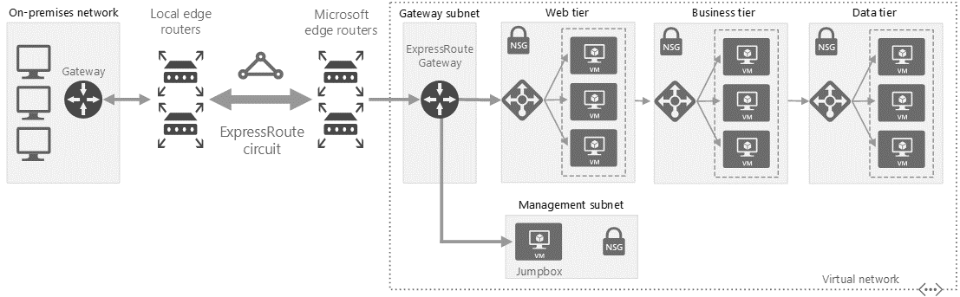
Hybrid Cloud Architecture
Include IDS/IPS, WAF
Include DB Firewall
Encryption
Key Mgmt.
Logging → ACE SIEM
AV
MFA

Slide 39
Cloud applications architecture - PaaS
Processes & Integration
Application Layer
Cloud Application Services
Front-end
Monitoring (SIEM)
Automation
SPA
Web Responsive
Mobile Native
Reports
BPM
Application Services
Document Generation
BRMS
Business Logic Services
Document Mgmt.
Integration
Data Layer
Session Mgmt.
Authorization
External API
Data
Key Mgmt. w/ HSM
ESB
Relational
NoSQL
Cache
Messaging
Processing
Firewall, IDS/IPS, WAF, DB Firewall
File Mgmt.
Events
Batch
Scheduler
Authentication
IaaS
Compute
Storage
Network
Provisioning
Backup
DRP
HA/LB
Change Mgmt.
Version Control
Audit

Slide 40
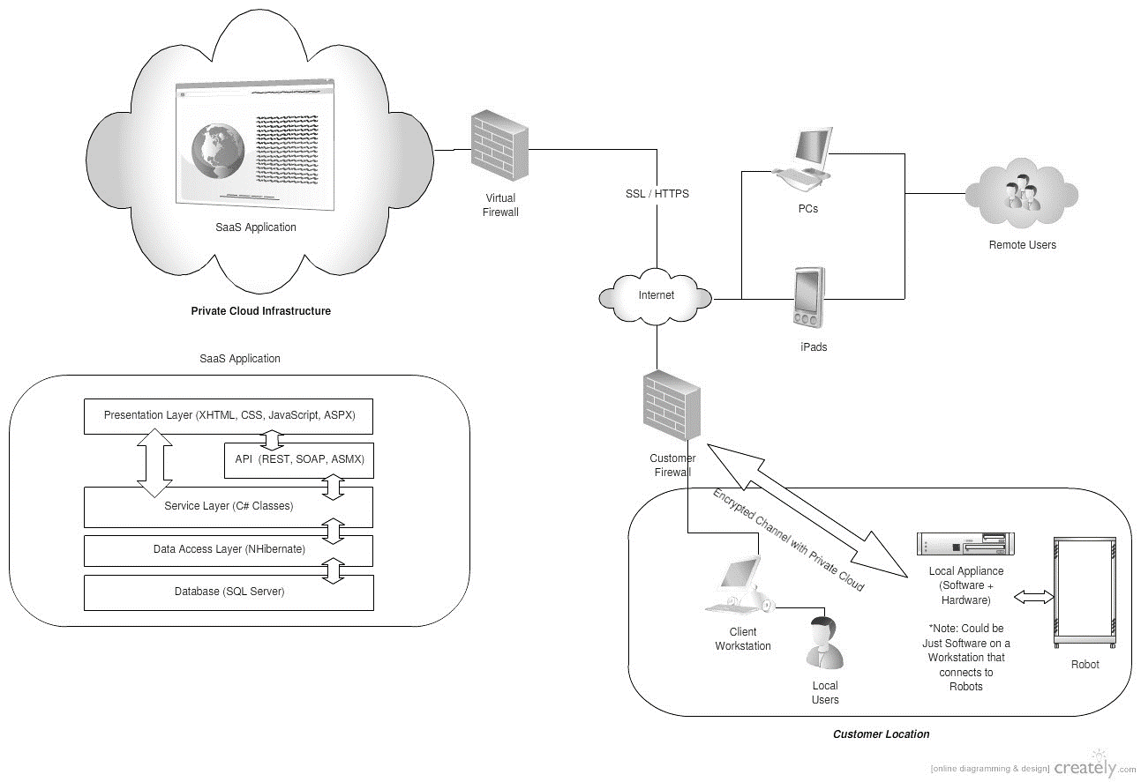
SaaS Network Architecture
(VPN into ACE to use
DLP, AV, other client and network security controls)
Private Connections (optional)
Use SSO/TLS to connect (over Internet)
ACE

Slide 41
Additional Hybrid Cloud Scenarios
(Representational)

Slide 42
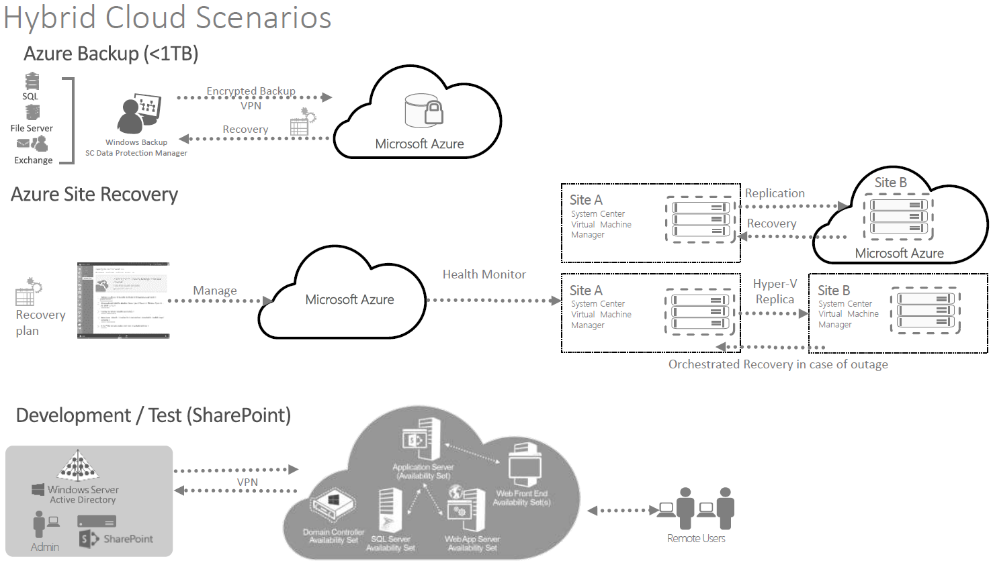

Slide 43
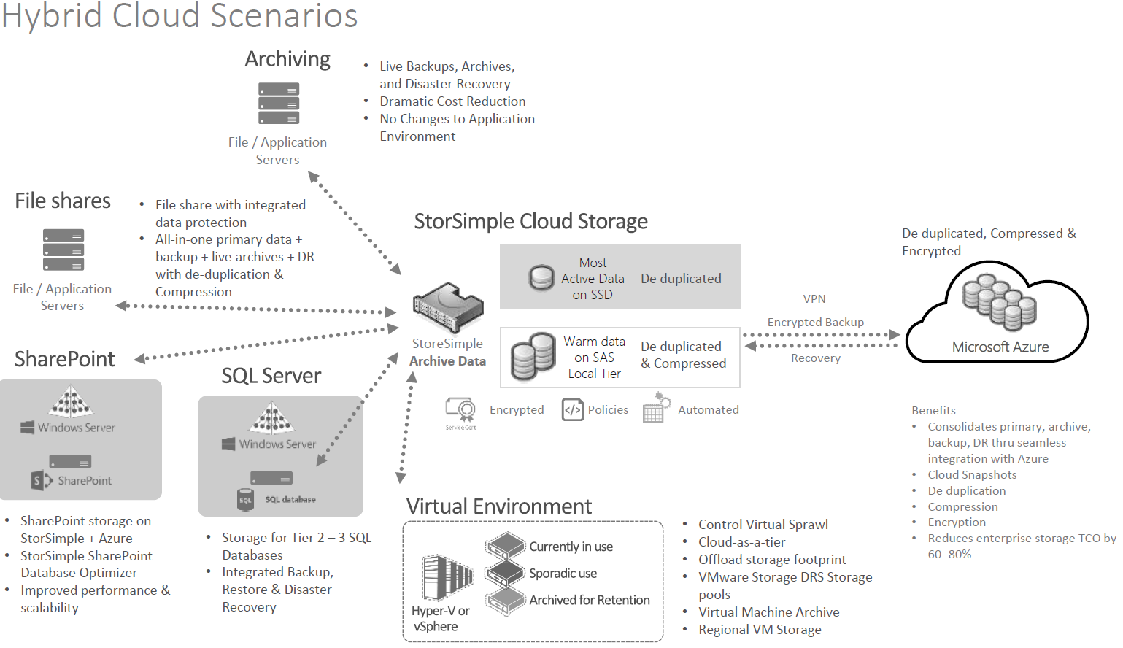

Slide 44
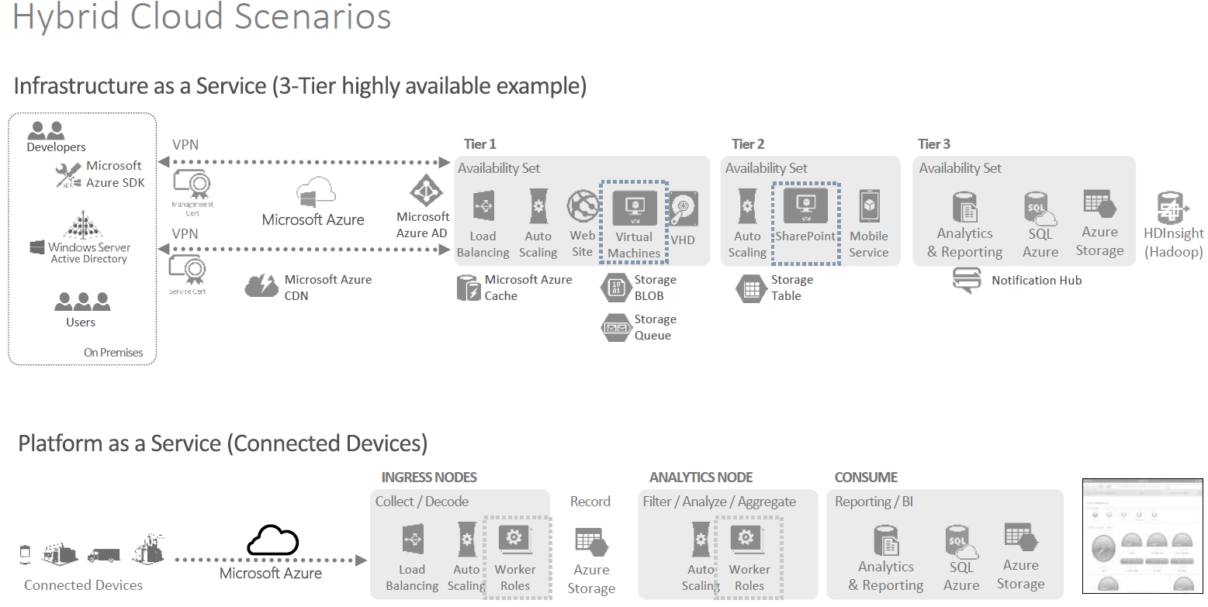

Slide 45
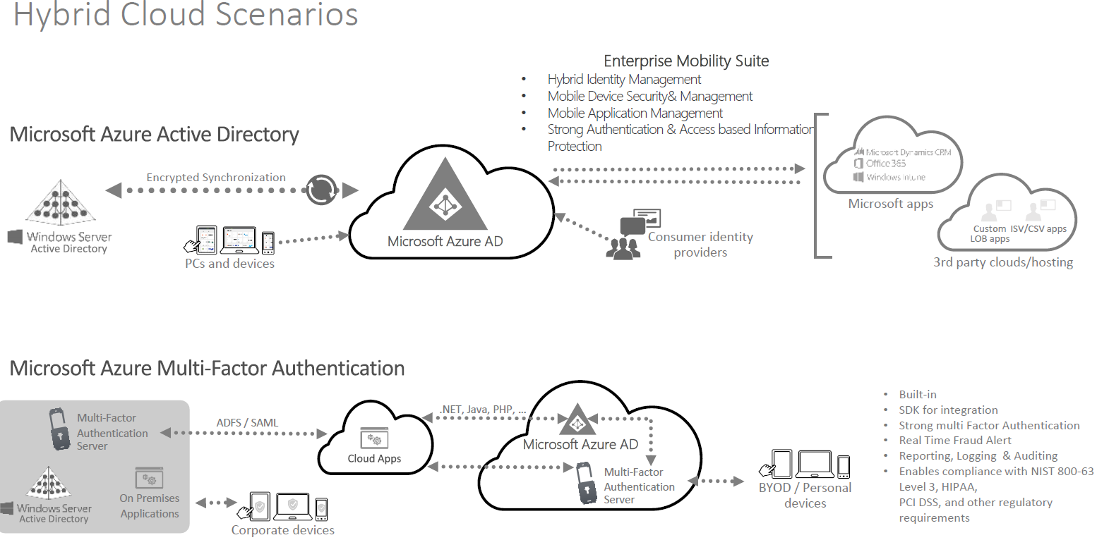

Slide 46
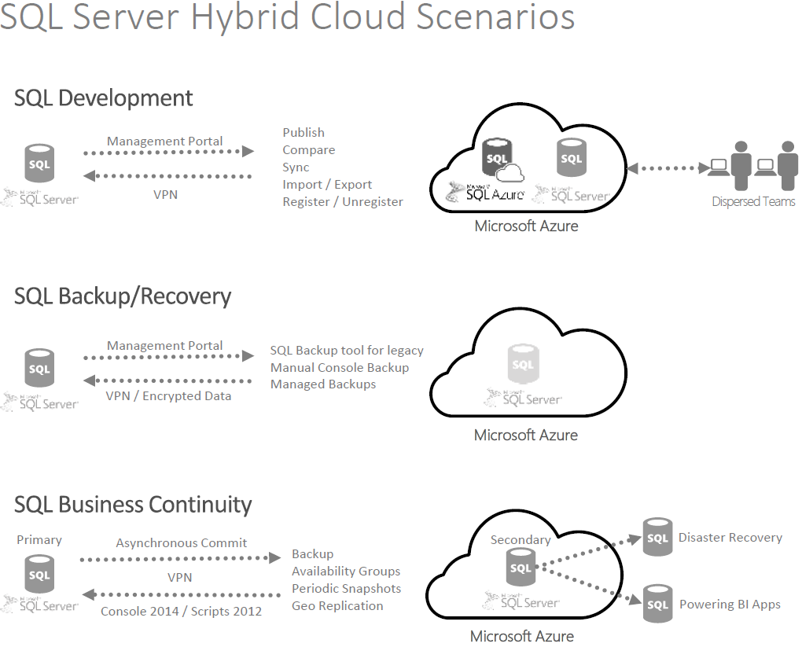

Slide 47
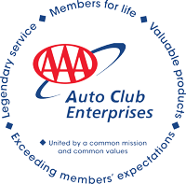
Thank You.
For questions, please contact:
Dave Cheema Cheema.Baldev@aaa-calif.com
Goutham Nellutla Nellutla.Goutham@aaa-calif.com

Slide 48
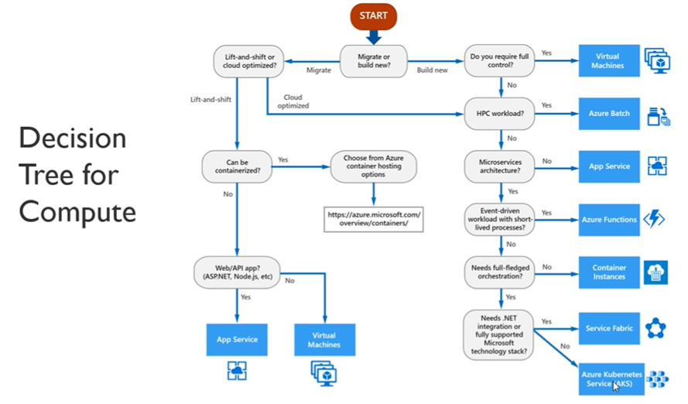

Slide 49
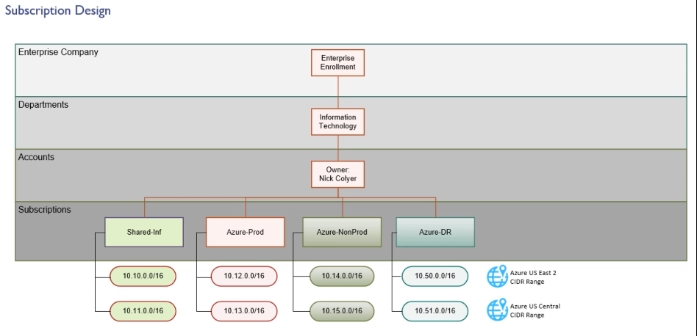

Slide 50
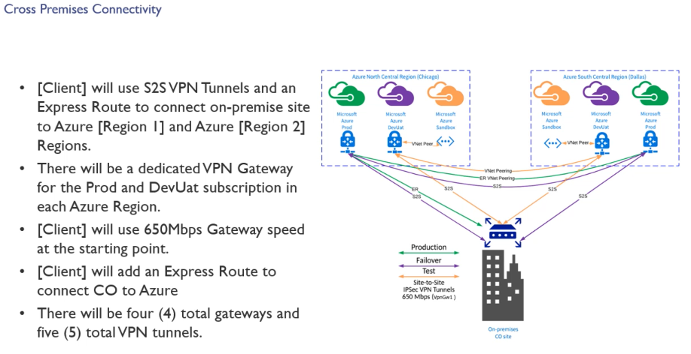

Slide 51
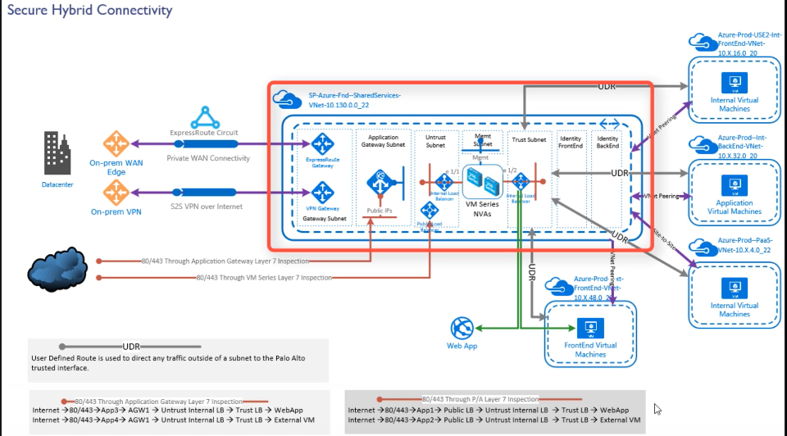

Slide 52
